Slide 1


VIRTUOSO'2020
Prospect and Introspect the Technological world.

Slide 2
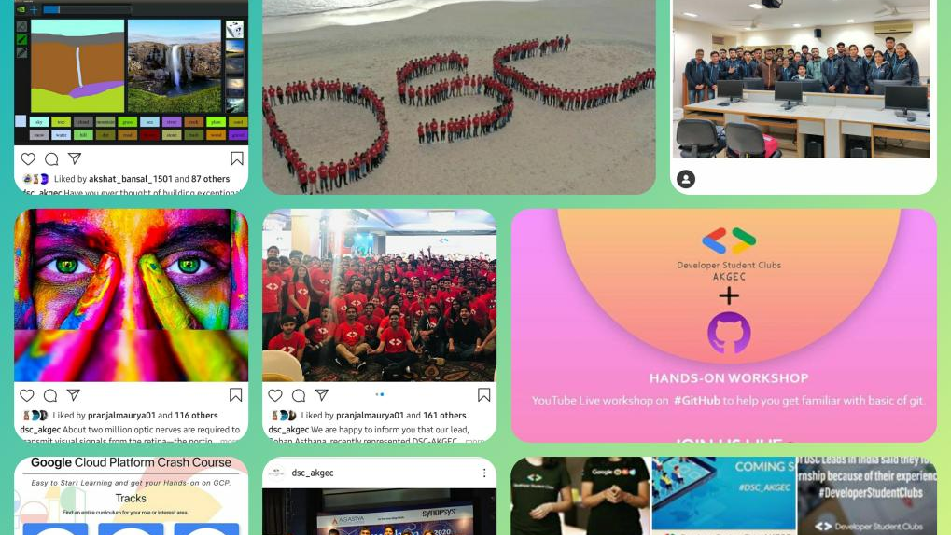
DEVELOPER SUDENTS CLUB, AKGEC

Slide 3
Content
1. Aim of the Event
2. About DSC
3. Domains and Activities
4. Some common queries
5. Conclusion

Slide 4

Aim of this Event
Fun Activities
Participate in fun activities and stand a chance to win so many goodies!!!
Learn
Introduction
Get to know about AOG, UIX and much more based on your domain of interest..
Get ready to dive into the world of knowledge with our experienced team.
To DSC, community that fosters the spirit of learning and a student focused development program by Google developers.

Slide 5
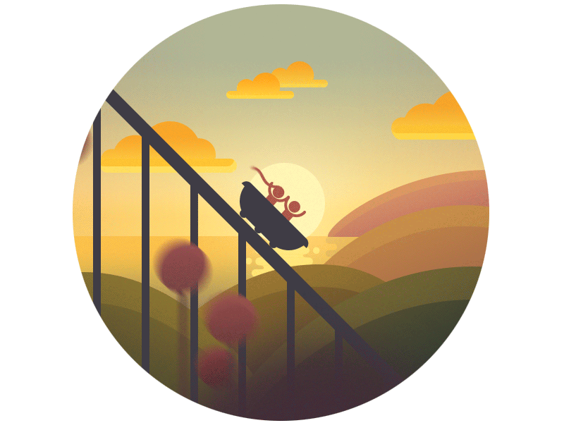
Ready for an adventurous ride filled with lots of learning and fun?

Slide 6
About DSC
A community of Google Developers.

Slide 7
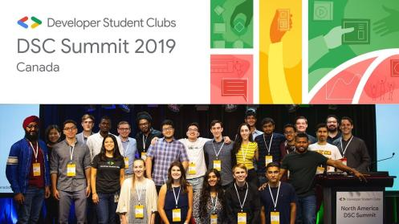
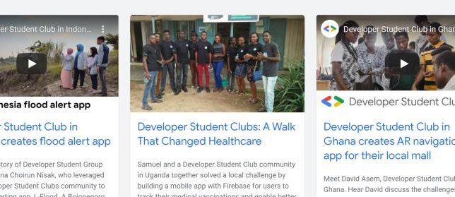
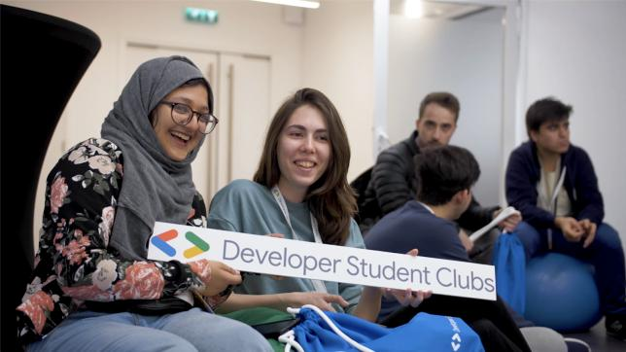
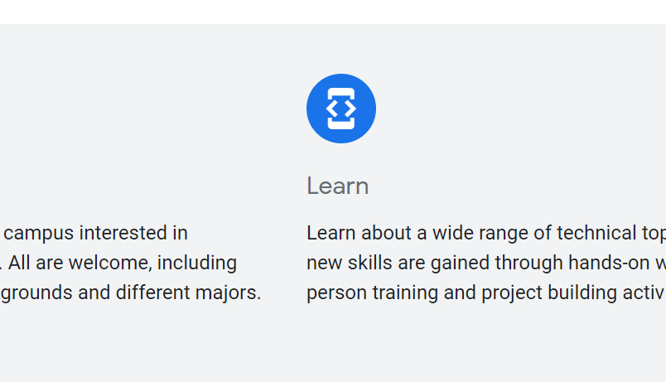

Slide 8



Connect
Learn
Grow
Meet other students on campus interested in developer technologies.
Learn about a wide range of technical topics where new skills are gained through hands-on workshops, in-person training and project building activities.
Apply your new learnings and connections to build great solutions for local problems. Advance your skills, career and network.

Slide 9

Our Team

Slide 10
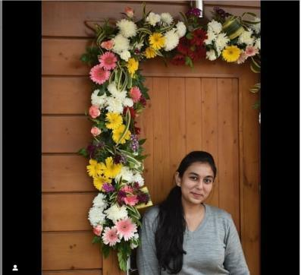
Ms. Mansi Goel
DSC, AKGEC LEAD

Slide 11
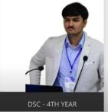
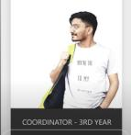
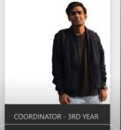
Our team
Aditya Gautam
Hitesh Tripathi
Rishabh Singh
App Development, 4th year
Web Development, 3rd year
App Development, 3rd year

Slide 12
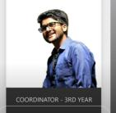
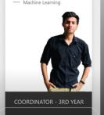
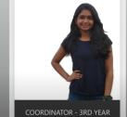
Our team
Apoorv Jain
Tarun Raghav
Pranjal Maurya
Machine Learning, 3rd year
Machine Learning, 3rd year
Management, 3rd year

Slide 13
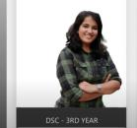
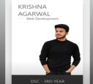
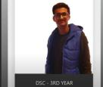
Our team
Shatakshi Upadhyay
Krishna Agarwal
Shubh Shah
App Development, 3rd year
Web Development, 3rd year
Management, 3rd year

Slide 14
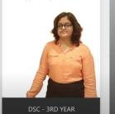
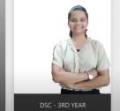
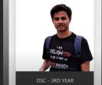
Our team
Anshika Bajpai
Vishesh Dhawan
Pranjul Itondia
App Development, 3rd year
Web Development, 3rd year
Machine Learning, 3rd year

Slide 15
Domains And Events

Slide 16
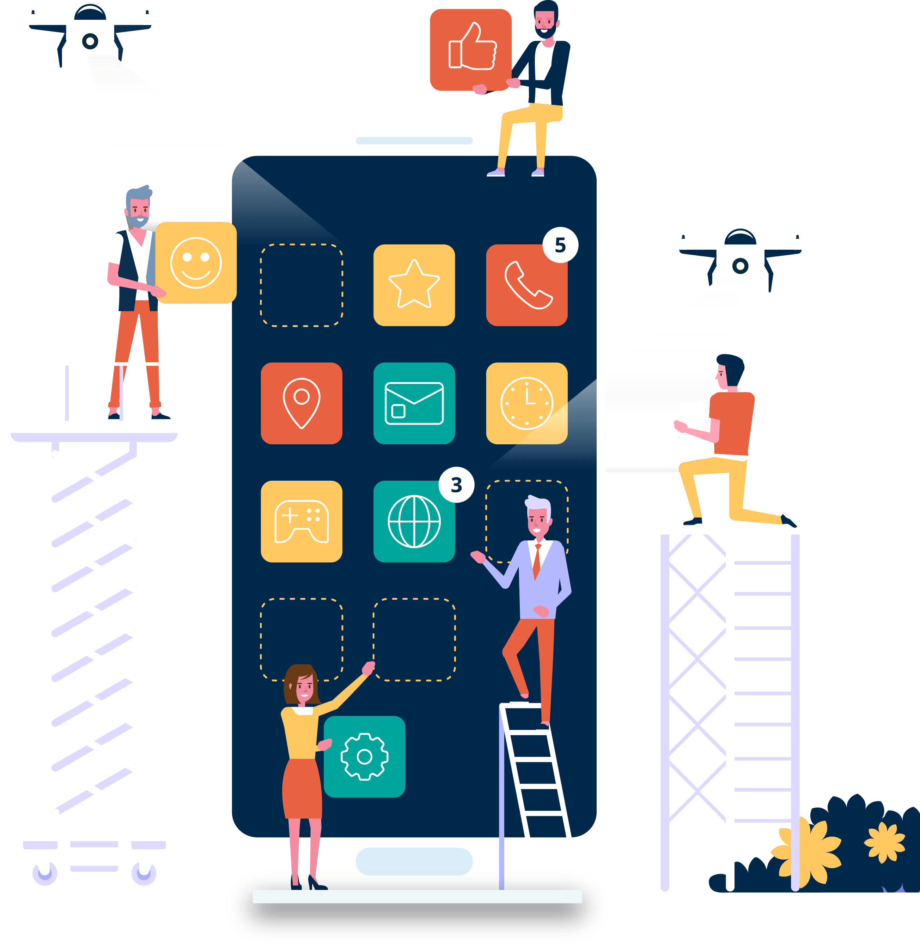
App Development
Mobile app development is the act or process by which a Mobile app is developed for devices.

Slide 17
Activity 1
Duration – 15-20 minutes
Platform – Google meet
Maximum Participants per session – 20-25

Slide 18

Let's make our own DSC app!

Slide 19
Make Your First Application In 5 Minutes!
1.
2.
3.
4.
Login/signup
Create App
Interact and show it to the audience
Best apps will be awarded with goodies!

Slide 20

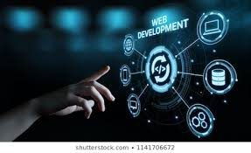


WEB DEVELOPMENT

Slide 21

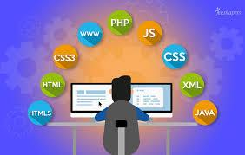

1. Websites are the basic requirements for any business, start-ups and play a major role in digital marketing.
2. They help us in organizing the info and facts.
3. Web-development is broadly divided into: Back-end development and front-end development.

Slide 22
Activity – 2 Duration – 20-25 mins Platform – Google meet Maximum participants per session - 20

Slide 23
Build your first web page with us!
1. A mail will be sent before the event regarding instructions to signup on the platform where participants will be making the website.
2. Our team will be guiding participants to write the HTML, CSS and JS code to create their own websites
3. At last, there will be a small online quiz and winners will be awarded with prizes.

Slide 24



Slide 25

Machine Learning
Artificial
Intelligence
and
Machine
Learning
Together
can do
wonders.
Machine learning is the science of getting computers to act without being explicitly programmed.

Slide 26
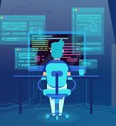
Activity – 3 Duration – 15-20 mins Platform – google meet Maximum participants per session – 10-15

Slide 27
Machine Learning is the last invention that humanity will ever need to make.
Nick Bostrom

Slide 28
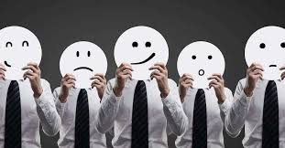
Face Recognition
1. Participants will be provided with the face recognition software made by our team.
2. They will be asked to open it on their respective screens and input their current mood facing the camera.
3. The computer will detect their mood through facial expressions or even voice.

Slide 29


Management
1. Capacity to perform executive duties.
2. planning, decision making, communication, delegation and time management.
3. Ability to tackle and solve frequent problems

Slide 30
Activity 4
Duration – 25-30 mins
Platform – Google meet
Maximum participants per session – 10 - 15

Slide 31
. “Technology is best when it brings people together.” - Matt Mullenweg

Slide 32
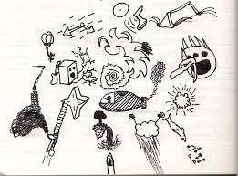
Draw your dreams into reality.
Inspired by Patti Dobrowolski

Slide 33
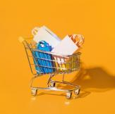

How to perform.
1. A participant will be asked to take a pen and paper and draw what he wants to become in the future on that paper
2. Now, a volunteer will be asked to predict the person's goals and thoughts from the image the participant has drawn

Slide 34
How to perform.
In this way, through team work, participants will learn the value of management and team work.
And, this interactive activity will make the environment warm and friendly among all.

Slide 35






Some Common Queries
Why DSC
Skills Required
Opportunities
Recruitment
Social Media Handles
Achievements

Slide 36
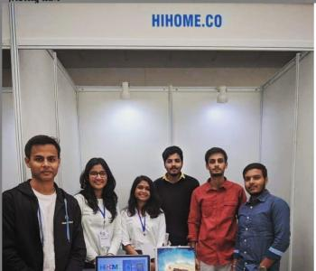
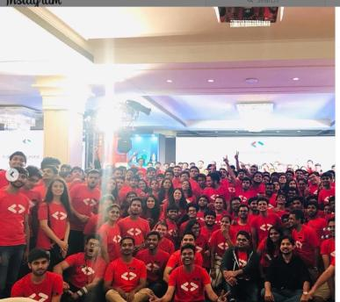
We hope you had a memorable experience.
Lets connect, learn, and grow together!

Slide 37
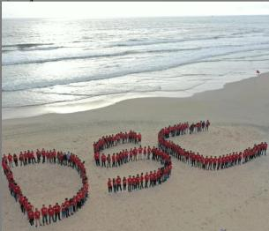
Thanks!
Connect with us:
Instagram: @dsc_akgec
Facebook: @dscAKGEC
LinkedIn: Developer Students Club AKGEC

Slide 38


Sponsorsed by -

